Slide 1
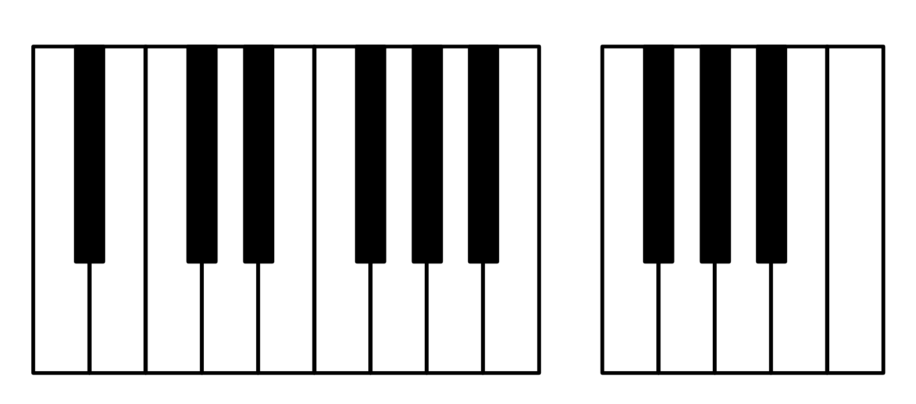

Black Notes: A#0 C#1 D#1 F#1 G#1 A#1
…
F#7 G#7 A#7
White Notes: A0 B0 C1 D1 E1 F1 G1 A1 B1
…
F7 G7 A7 B7 C8
…
22 25 27 30 32 34
102 104 106
MIDI Note Number $p=$
101 103 105 107 108
21 23 24 26 28 29 31 33 35
The 1st Octave
…
The 7th Octave

Slide 2
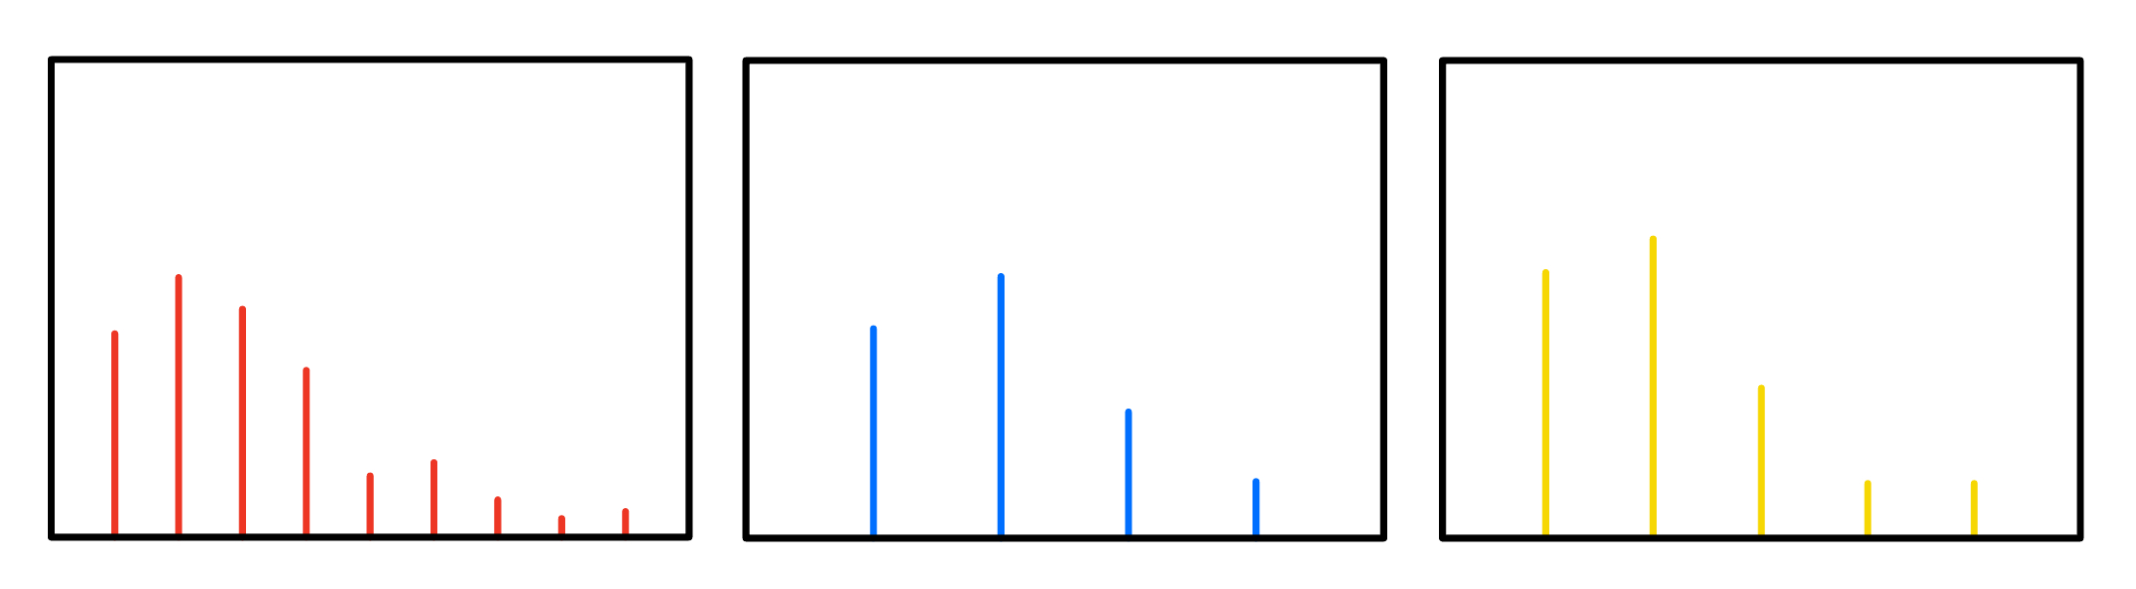
Separate Frequency Spectrums
Note 1
Note 2
Note 3
Magnitude
f₁ 2f₁ 3f₁ 4f₁ 5f₁ 6f₁ 7f₁ 8f₁ 9f₁
f₂ 2f₂ 3f_{z} 4f₂
f₃ 2f₃ 3f₃ 4f₃ 5f₃
Frequency (Hz)
Frequency (Hz)
Frequency (Hz)

Slide 3
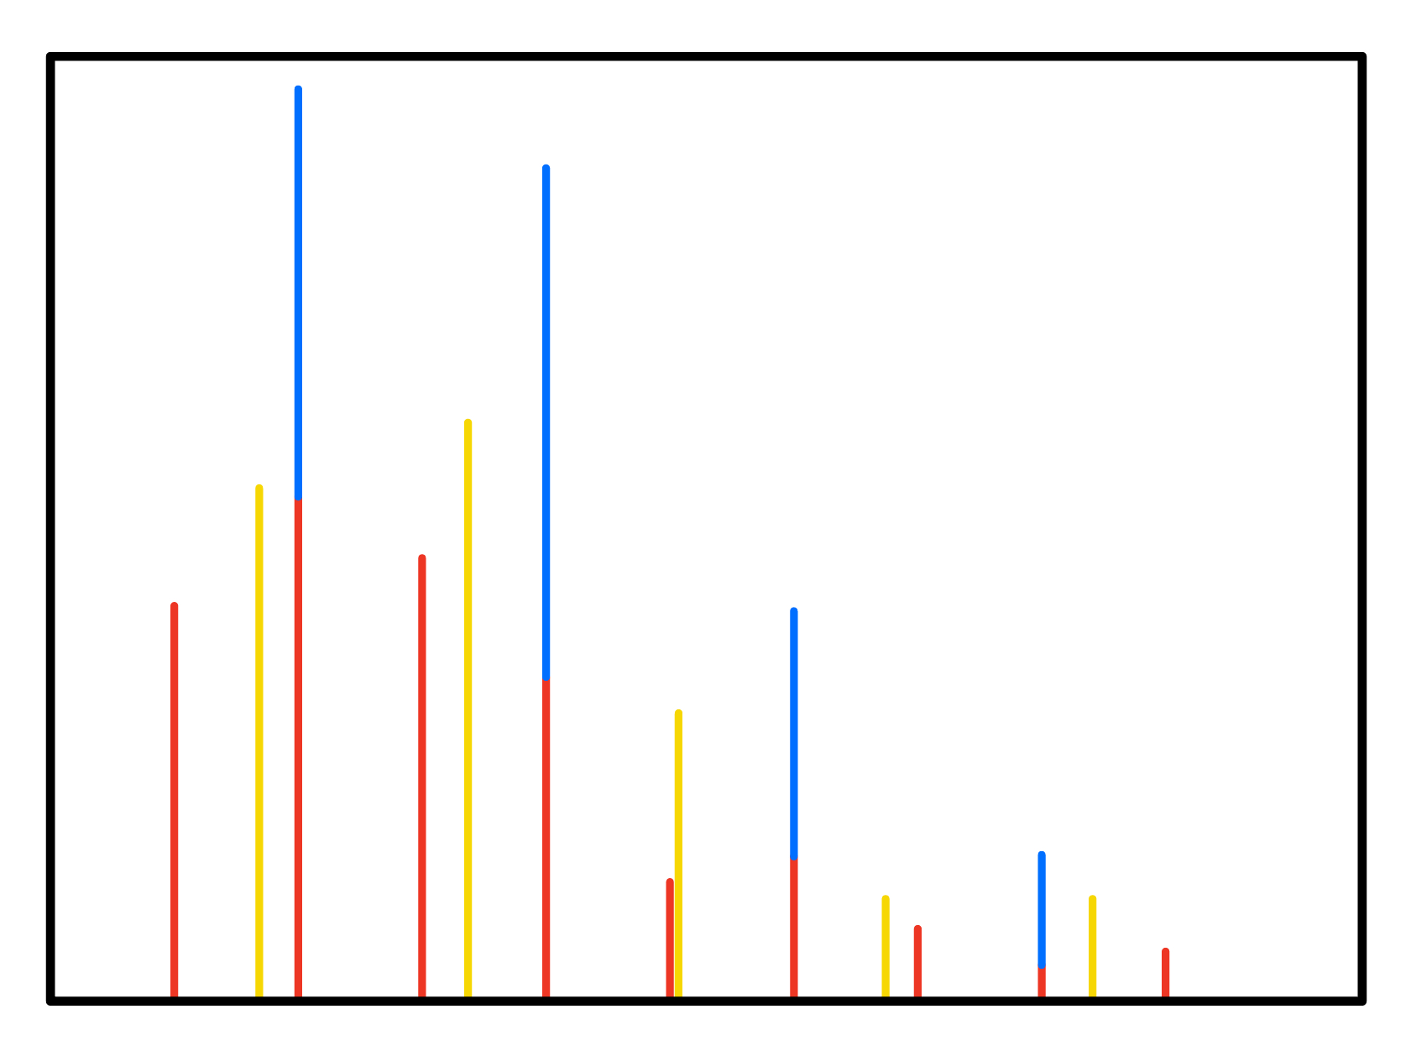
Combined Frequency Spectrum
Magnitude
Frequency (Hz)

Slide 4
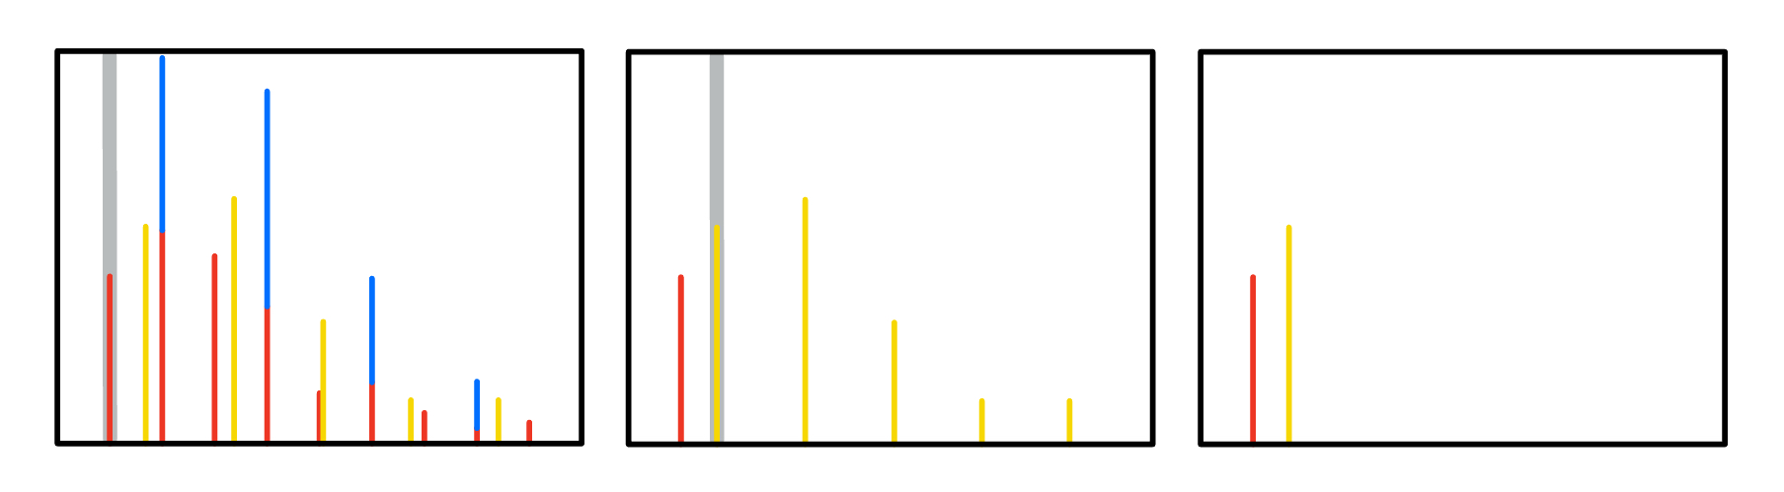
Magnitude
Frequency (Hz)
Frequency (Hz)
Frequency (Hz)
Choose the lowest frequency (note 1)
Eliminate all multiples of note 1, choosing the next lowest frequency (note 2)
Eliminate all multiples of note 2, stop

Slide 5
Magnitude
Frequency (Hz)
Frequency (Hz)
Frequency (Hz)
(a)
(b)
(c)

Slide 6
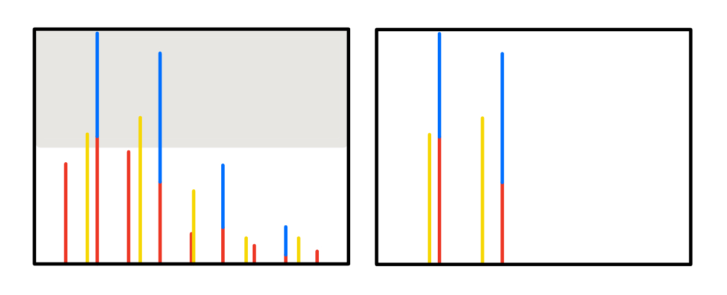
Magnitude
Frequency (Hz)
Frequency (Hz)
Check all magnitudes by the boundary
Eliminate frequencies with magnitudes lower than boundary

Slide 7
Magnitude
Frequency (Hz)
Frequency (Hz)
(a)
(b)

Slide 8
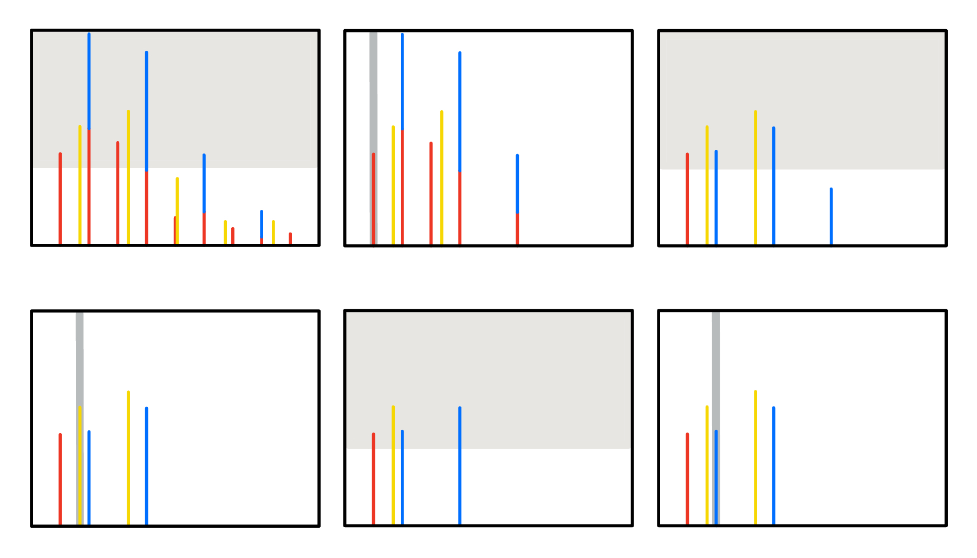
Magnitude
Frequency (Hz)
Frequency (Hz)
Frequency (Hz)
(a) Check all magnitudes by the boundary
(b) Eliminate frequencies with magnitudes lower than boundary, choose the lowest frequency (note 1)
(c) Subtract the magnitudes contributed by overtones of note 1, check by the boundary

Slide 9
Magnitude
Frequency (Hz)
Frequency (Hz)
Frequency (Hz)
(a)
(b)
(c)

Slide 10
Magnitude
Frequency (Hz)
Frequency (Hz)
Frequency (Hz)
(d)
(e)
(f)

Slide 11
Magnitude
(a) Check magnitudes, keep those higher than threshold
(b) Choose the lowest frequency
(c) Subtract overtones, check magnitudes
Magnitude
Frequency (Hz)
Frequency (Hz)
Frequency (Hz)
(d) Choose the next lowest frequency
(e) Subtract overtones, check magnitudes
(f) Choose the next lowest frequency

Slide 12
Magnitude
Frequency (Hz)
Frequency (Hz)
Frequency (Hz)
(d) Eliminate frequencies with magnitudes lower than boundary, choose the next lowest frequency (note 2)
(e) Subtract the magnitudes contributed by overtones, check by the boundary
(f) Eliminate frequencies with magnitudes lower than boundary, choose the next lowest frequency

Slide 13
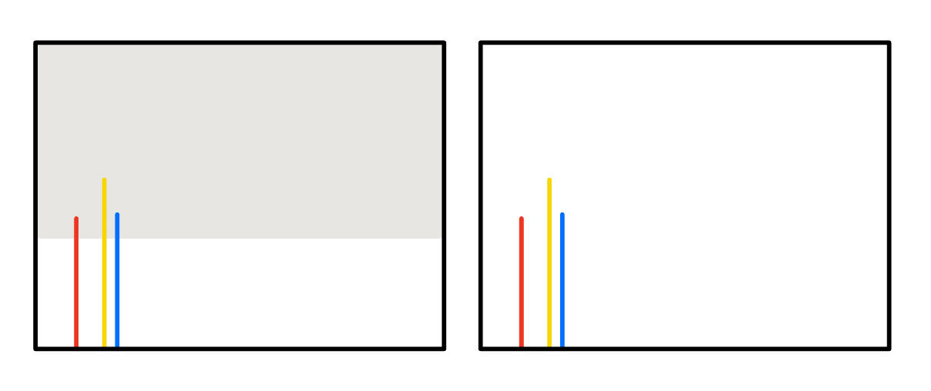
Magnitude
Frequency (Hz)
Frequency (Hz)
(g)
(h)

Slide 14
(g) Subtract the magnitudes contributed by overtones, check by the boundary
(h) No next

